Slide 1


Deep Learning
Project
Image Classification with CNN
Dani Siaj / Carlos Rodríguez
Data Science & Machine Learning Bootcamp 18/10/2024

Slide 2
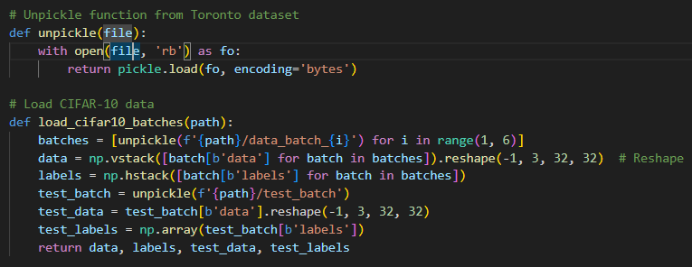
LOADING ‘CIFAR-10’ DATA SET
Downloading batches from cs.toronto.edu website
2) Importing directly into the ipynb using ‘tensorflow.keras.datasets’
Data Science | Machine Learning

Slide 3


DATA PREPROCESSING (tensorflow)
Normalization
One-hot encoding
Data Science | Machine Learning

Slide 4
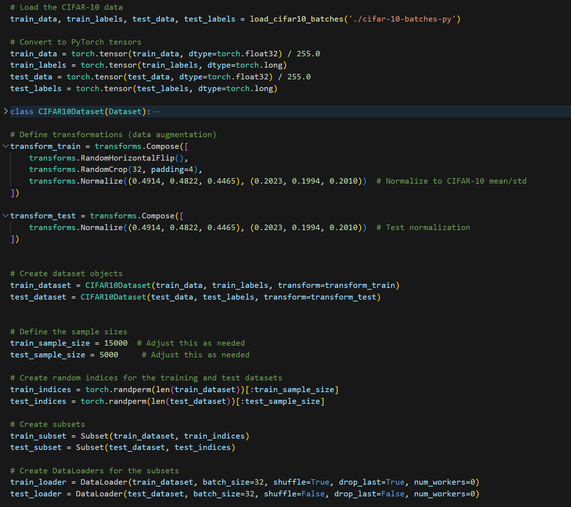
DATA PREPROCESSING (pytorch)
Build Train and Test datasets
Convert to pytorch tensors
Data augmentation:
Random Horizontal Flip
Random Crop
Normalization
Standardization
Sampling and Shuffling
Combine data and labels into ‘loader’
Data Science | Machine Learning

Slide 5
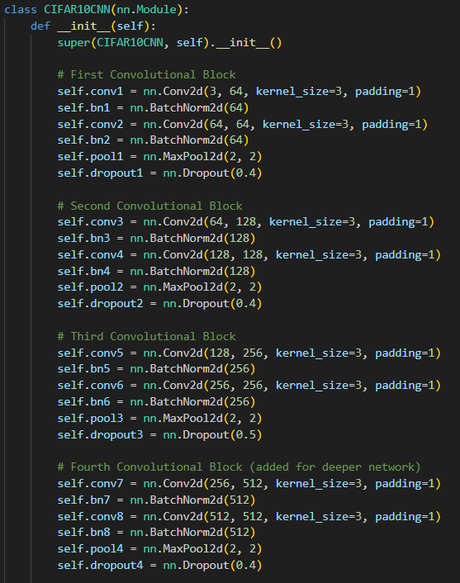
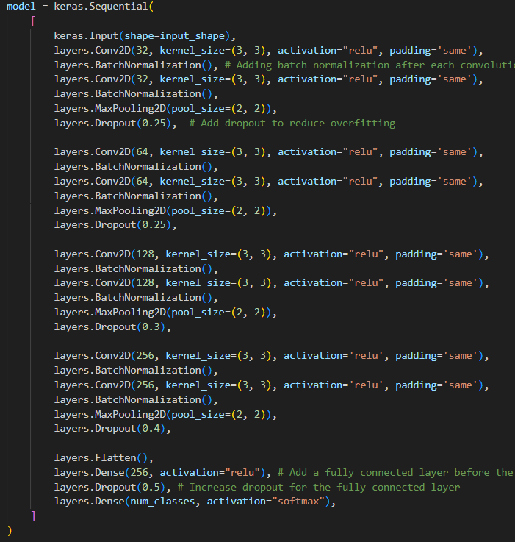
2. MODEL ARCHITECTURE
CNN Model using Pytorch
2. CNN Model using Tensorflow
Data Science | Machine Learning

Slide 6
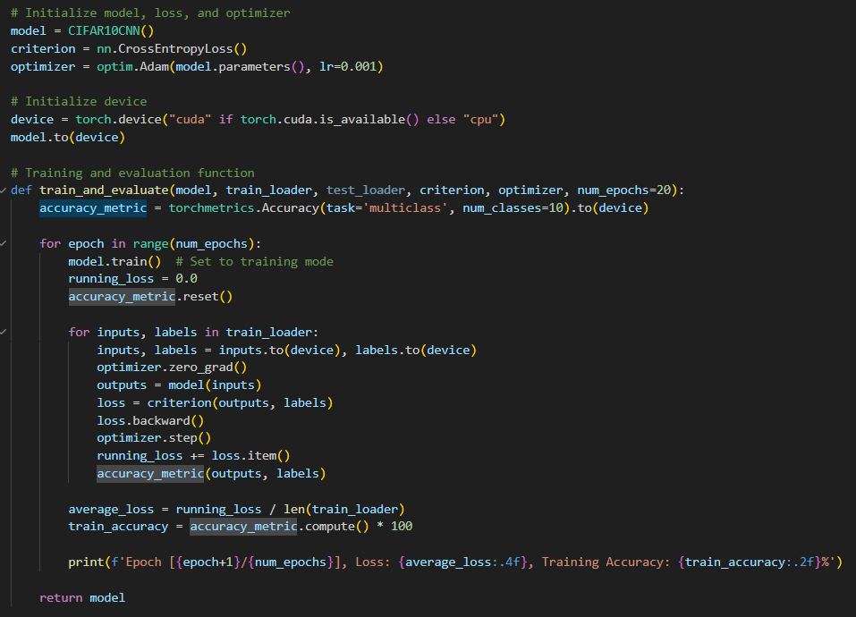
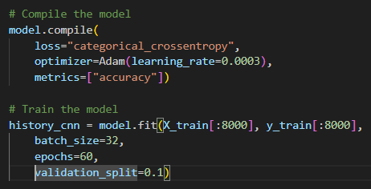
3. MODEL TRAINING
CNN Model using Pytorch
2. CNN Model using Tensorflow
Data Science | Machine Learning

Slide 7
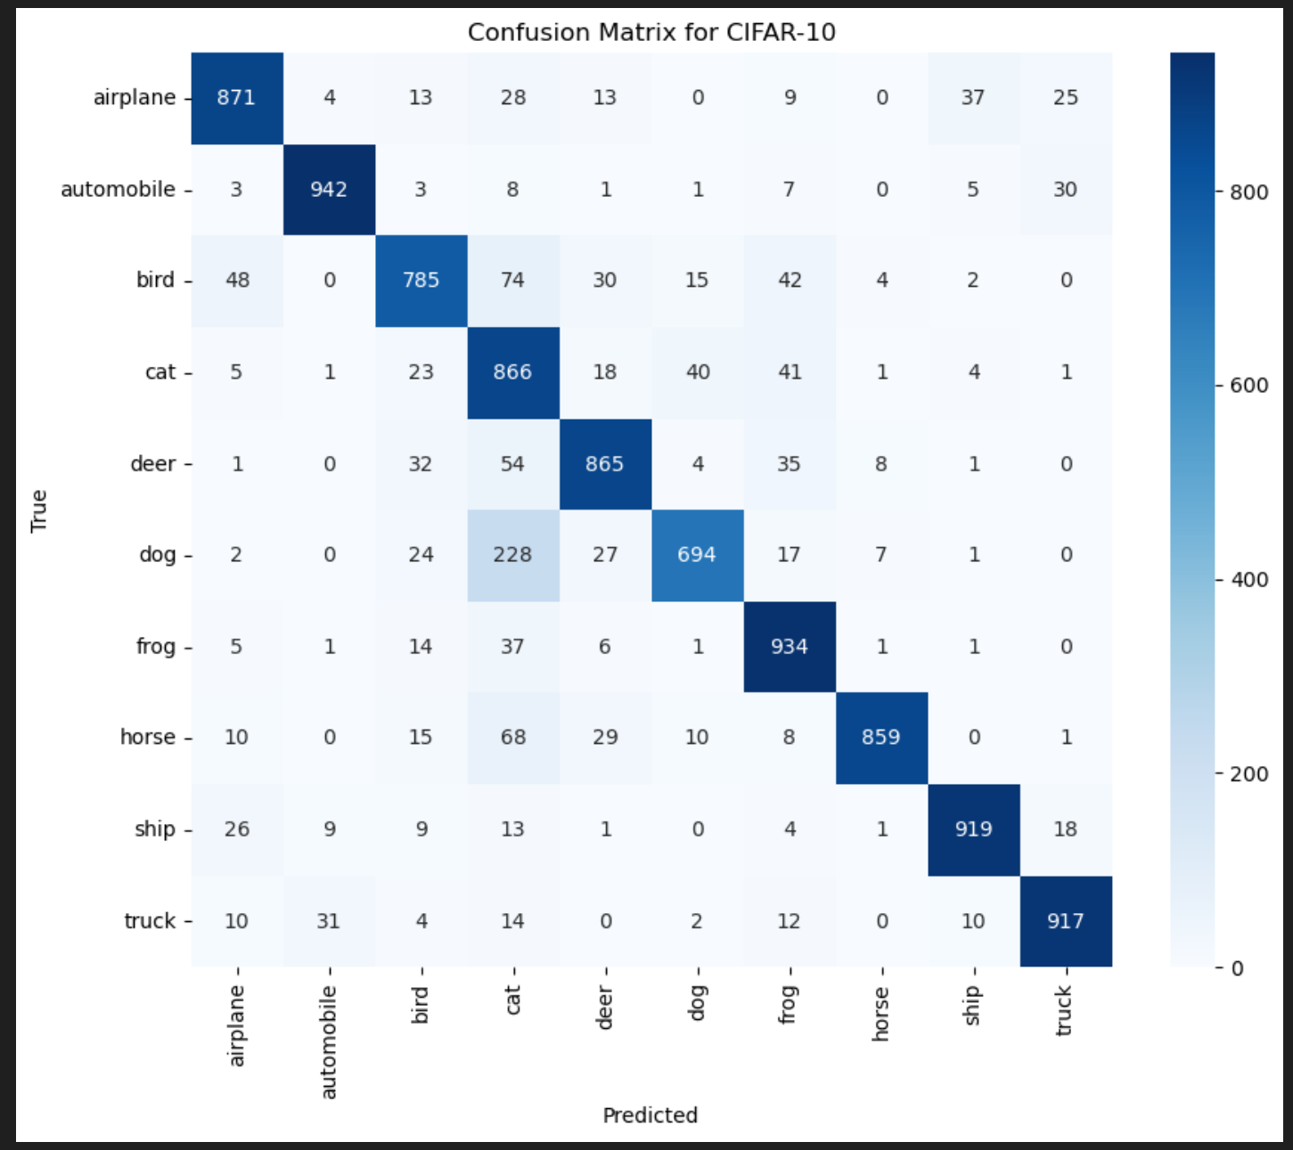
4. MODEL EVALUATION
MODEL | TEST ACCURACY | TEST LOSS
CNN Pytorch | 0.86 | 0.15
CNN Tensorflow | 0.72 | 1.37
Confusion matrix reveals…
— Strengths: frogs, automobiles, trucks and ships.
— Confusions: dogs vs. cats & birds vs. cats
Data Science | Machine Learning

Slide 8
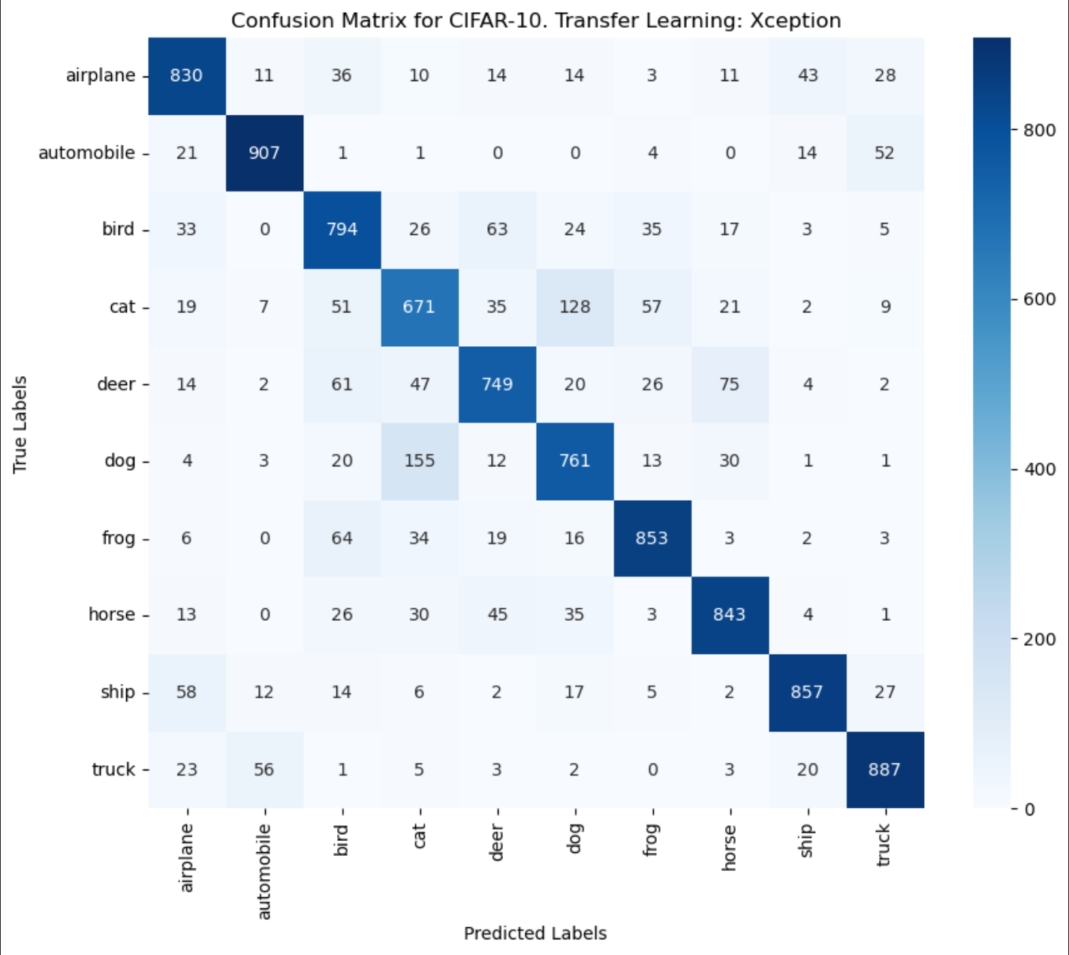
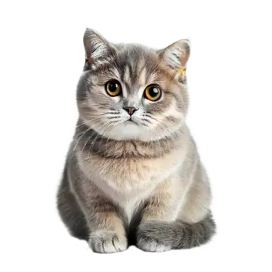
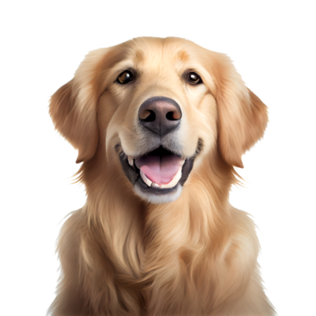
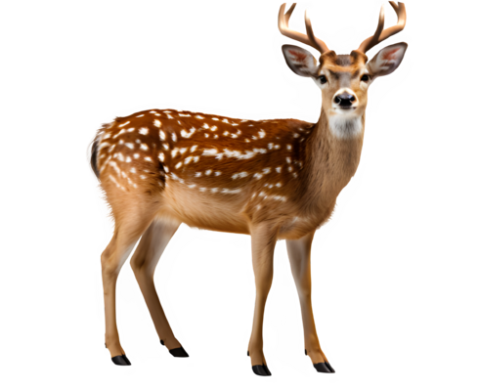
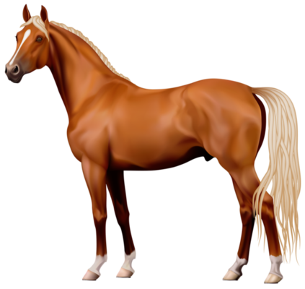
5. TRANSFER LEARNING
PRE-TRAINED MODEL | TEST ACCURACY | TEST LOSS
Xception | 0.82 | 0.15
VGG16 | 0.65 | 1.71
Transfer learning models also fail to recognize visually similar images like cats and dogs, deer and horses and even trucks and automobiles.
Data Science | Machine Learning

Slide 9

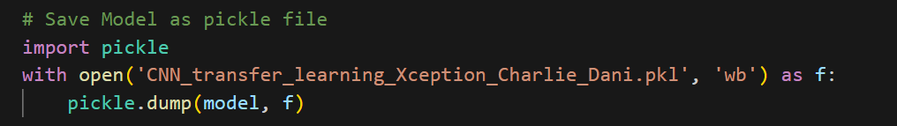


SAVE TRAINED MODELS
CNN MODELS
PRE TRAINED MODELS
In Pytorch
1. Xception
2. In Tensorflow
2. VGG16
Data Science | Machine Learning

Slide 10
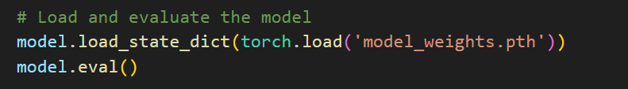
LOAD TRAINED MODEL (PYTORCH)
Data Science | Machine Learning

Slide 11
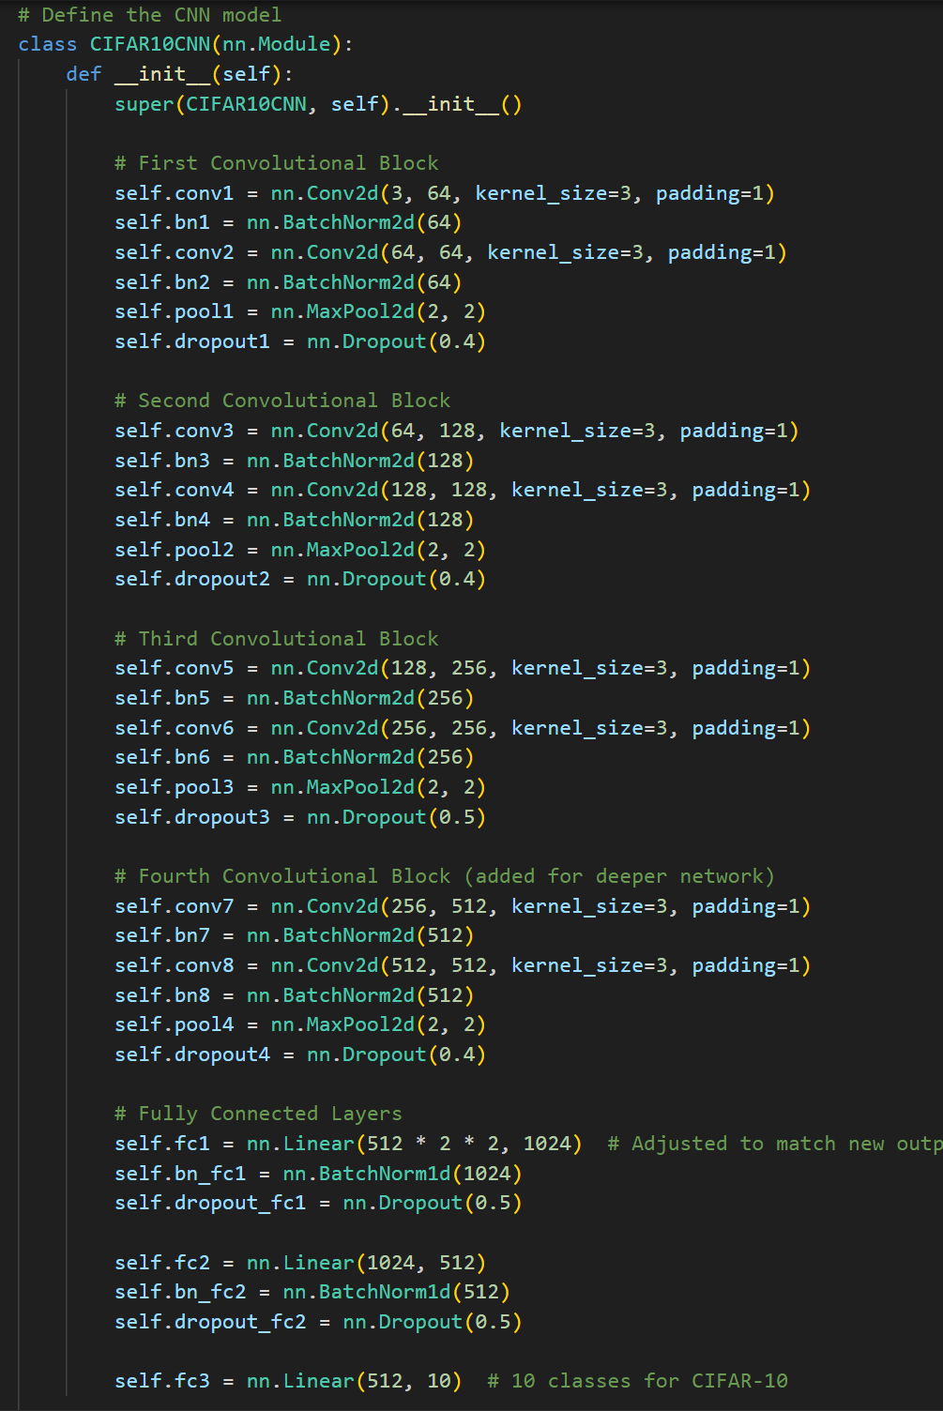
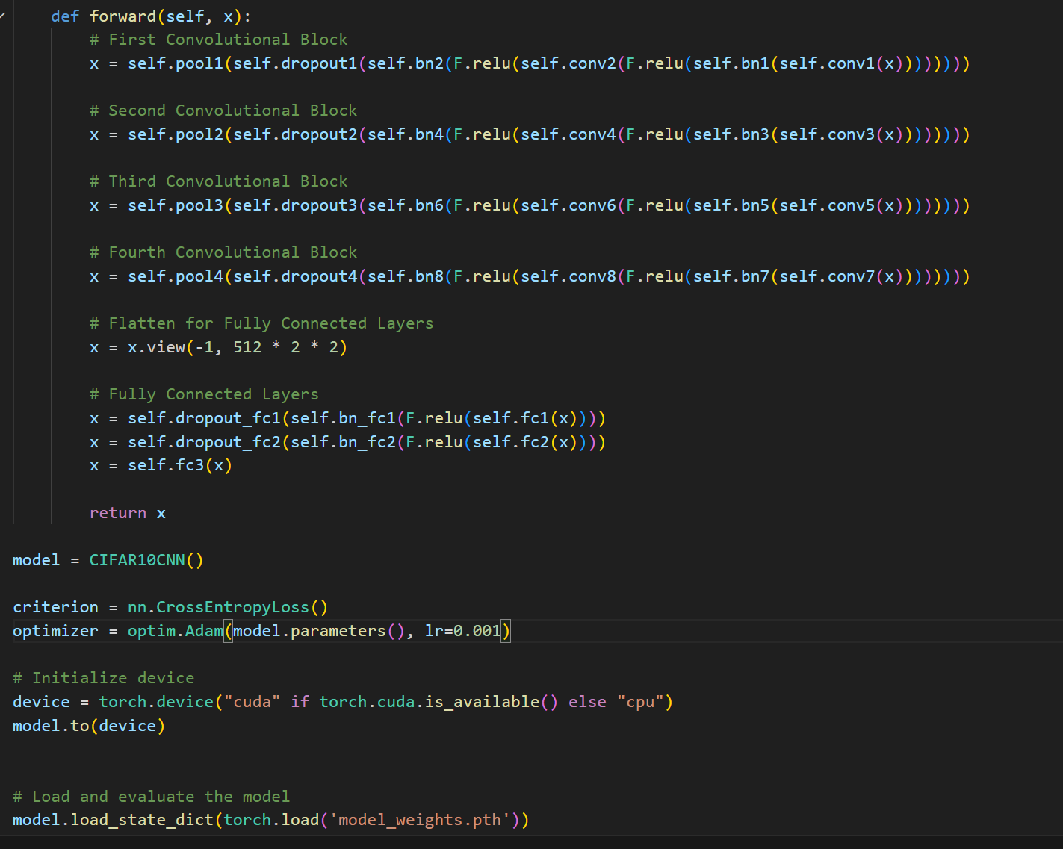
LOAD TRAINED MODEL (PYTORCH)
Data Science | Machine Learning

Slide 12
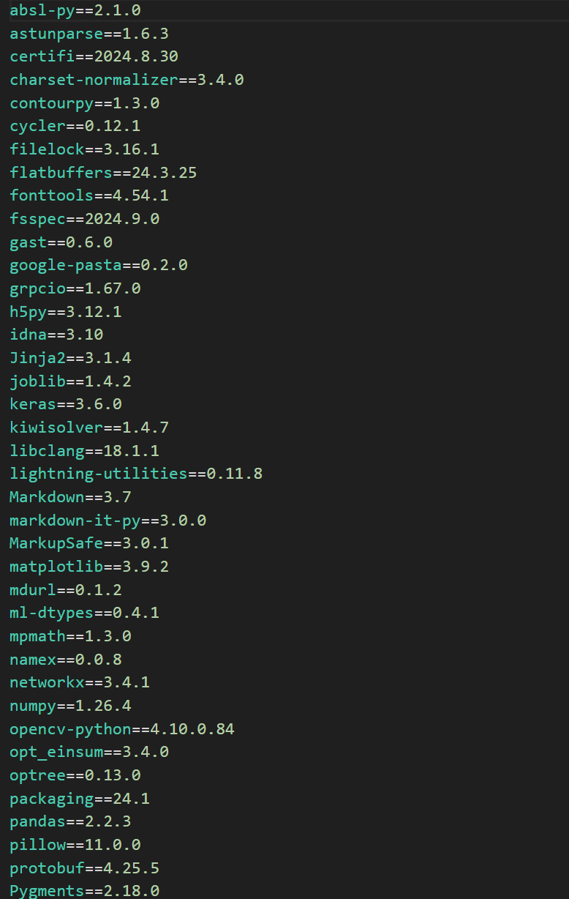
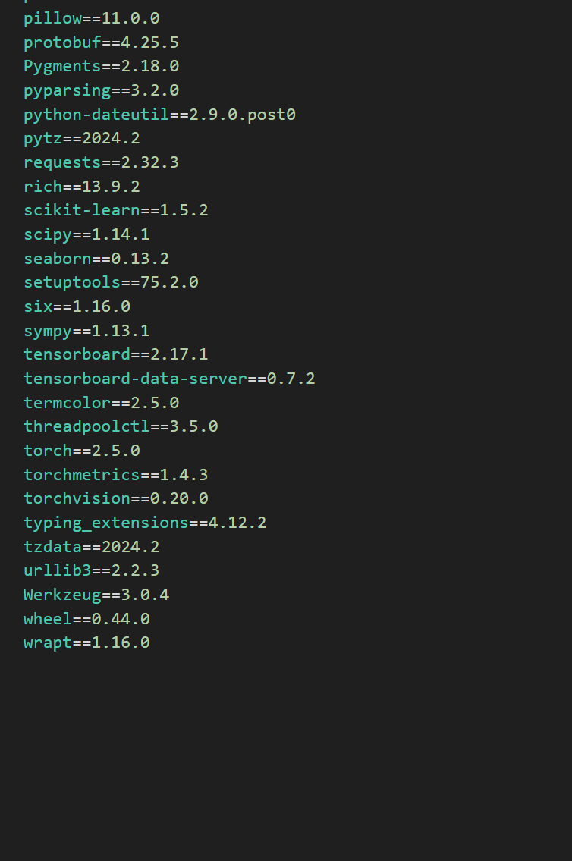
REQUIREMENTS
Data Science | Machine Learning

Slide 13
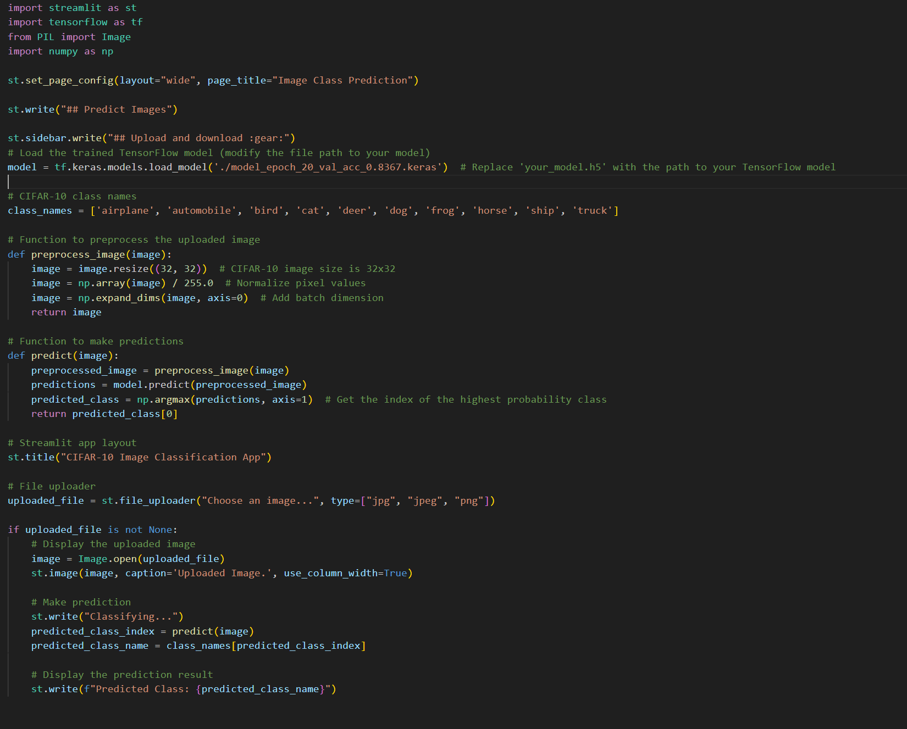
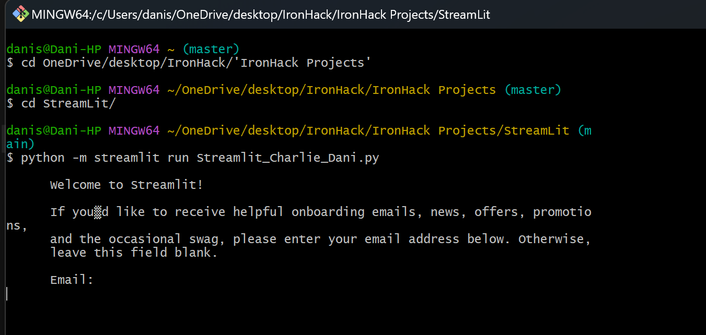
6. STREAMLIT APP (failed…)

